Slide 1
Signal Strength
The strength of a signal is measured by how closely it approximates an ideal voltage source.
V_{DD} and GND rails are strongest 1 and 0
nMOS pass strong 0
But degraded or weak 1
pMOS pass strong 1
But degraded or weak 0
Thus nMOS are best for pull-down network

Slide 2
Pass Transistors
When a transistor is used as switch
We get a pass transistor
28-Feb-21
2

Slide 3
Transmission Gates
Pass transistors produce degraded outputs
Transmission gates pass both 0 and 1 well

Slide 4
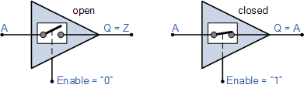
Tri-state
Digital Buffer Circuit
Known as 3-state Buffer or Tri-state Buffer
An external “Control” or “Enable” ( EN ) controls the input
When Enable is ON, Input goes to Output
Otherwise, a floating Z state is obtained at the Output
A tri-state buffer requires two inputs. One being the data input and the other being the enable or control input

Slide 5
Tri-state
Tristate buffer produces Z when not enabled
EN | A | Y
0 | 0 | Z
0 | 1 | Z
1 | 0 | 0
1 | 1 | 1

Slide 6
Non-restoring Tri-state
Transmission gate acts as tristate buffer
only requires two transistors but it is a non restoring circuit
If the input is noisy or otherwise degraded, the output will receive the same noise
EN | A | Y
0 | 0 | Z
0 | 1 | Z
1 | 0 | 0
1 | 1 | 1

Slide 7
Tri-state Inverter
Tristate inverter produces restored output
Violates conduction complement rule
Because we want a Z output

Slide 8
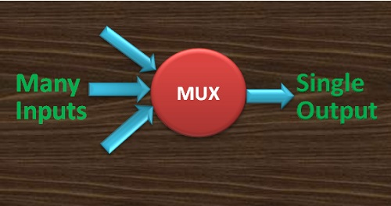
Multiplexers (MUX)
The multiplexer is a combinational logic circuit designed to switch one of several input lines to a single common output line.
Multiplexers are key components in CMOS memory elements and data manipulation structures.
2:1 multiplexer chooses between two inputs

Slide 9
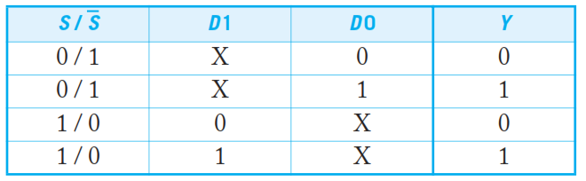
Multiplexer truth table
$$Y=SD_{1}+\overline{S}D_{0}$$

Slide 10
Transmission Gate Mux
Non-restoring mux uses two transmission gates
Only 4 transistors

Slide 11
Inverting Mux
Inverting multiplexer
Use compound AOI22
Or a pair of tristate inverters
Essentially the same thing
Noninverting multiplexer adds an inverter

Slide 12
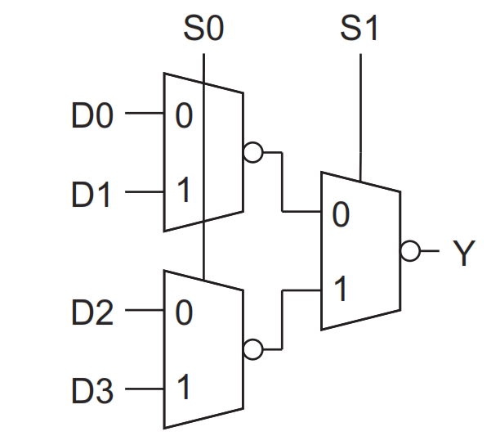
4:1 Multiplexer
4:1 mux chooses one of 4 inputs using two selects
Two levels of 2:1 muxes
Or four tristates

Slide 13

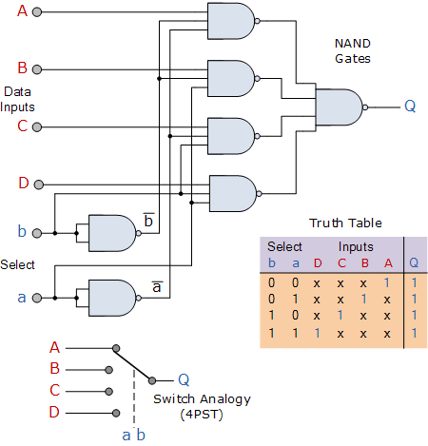
4:1 Multiplexer
The Boolean expression for this 4-to-1 Multiplexer above with inputs A to D and data select lines a, b is given as:

Slide 14
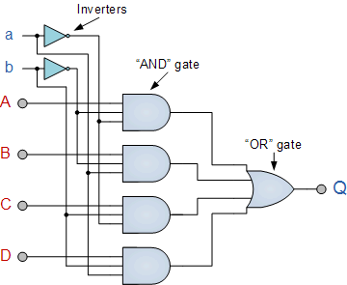
4:1 Multiplexer using OR gate

Slide 15
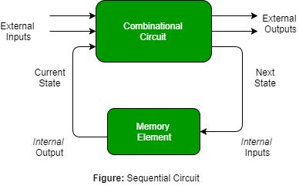
Sequential circuit
A sequential circuit is a logical circuit, where the output depends on the present value of the input signal as well as the sequence of past inputs.
Example: latches , ﬂip-ﬂops

Slide 16
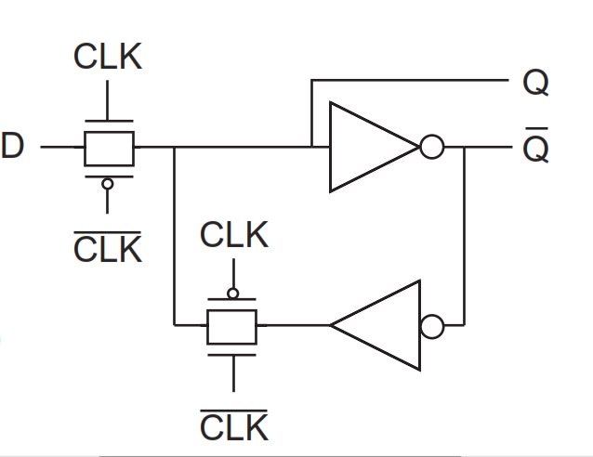
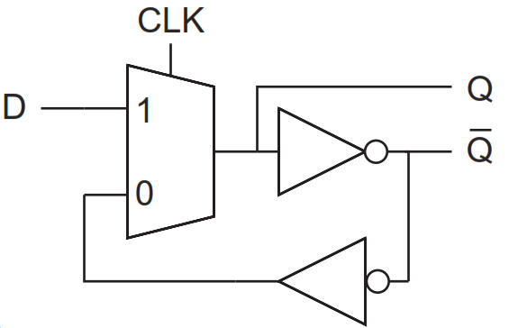
D Latch
The data latch is an easy expansion to the gated SR-latch that eliminates the chance of unacceptable states of input.
D latch is built from a 2-input multiplexer and two inverters.
The multiplexer is built from a pair of transmission gates

Slide 17
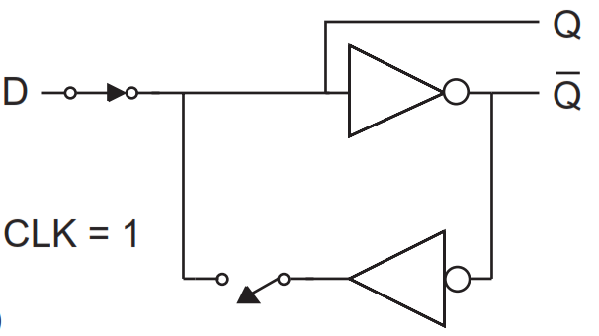
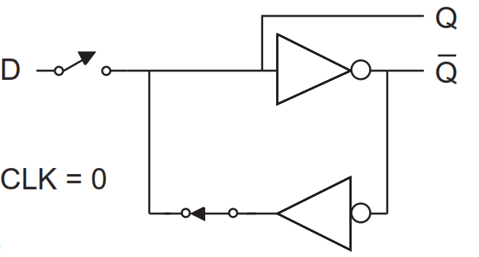
D Latch Operation
When CLK = 1, the latch is transparent and D ﬂows through to Q.
When CLK falls to 0, the latch becomes opaque. A feedback path around the inverter pair is established to hold the current state of Q indeﬁnitely.

Slide 18
D Latch Operation
Also known as a level-sensitive latch because the state of the output is dependent on the level of the clock signal

Slide 19
D-Flip-flop
By combining two level-sensitive latches, one negative-sensitive and one positive-sensitive, we construct the edge-triggered ﬂip-ﬂop.
The ﬁrst latch stage is called the master and the second is called the slave.

Slide 20
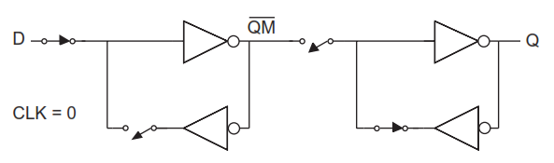
D Flip-flop
While CLK is low, the master negative-level-sensitive latch output (QM) follows the D input while the slave positive-level-sensitive latch holds the previous value.

Slide 21
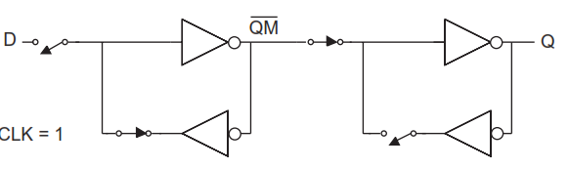
D Flip-flop
When the clock transitions from 0 to 1, the master latch becomes opaque and holds the D value at the time of the clock transition.
The slave latch becomes transparent, passing the stored master value (QM) to the output of the slave latch (Q).
The D input is blocked from affecting the output because the master is disconnected from the D.

Slide 22
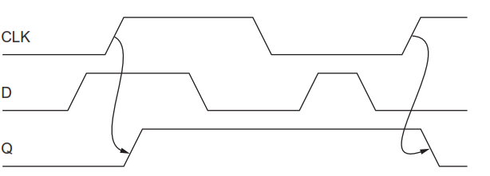
D Flip-flop
D flip-flop is called a positive-edge triggered ﬂip-ﬂop.
Also called a D ﬂip-ﬂop, D register, or master–slave ﬂip-ﬂop.
A collection of D ﬂip-ﬂops sharing a common clock input is called a register.
A register is often drawn as a ﬂip-ﬂop with multi-bit D and Q busses.

